Slide 1

Service Performance Management
ISO27001 – Management Training

Slide 2

Introduction
This training session is focused on providing a high-level overview of ISO27001, and how this has been designed to support Aggreko Technology Services.
This will focus on providing an overview on the development, planning and execution of the Information Security Management System (ISMS).
This training will reference Legislation, Policies, Standards and Standard Operating procedures, which will support Information Security Management System objectives from Senior Leadership level.

Slide 3
Agenda and Objectives
Agenda
ISO27001 Overview and structure
Aggreko Technology Services – Information Security Management System
Risk Management, Compliance and Conformance overview
Governance overview
Roles and Responsibilities
Objectives
Provide a high-level overview of how the ISO27001 Framework has been designed for ATS.
Create awareness and communicate the structure of ISO27001.
Supplement the training delivered for the policies and standards.
Provide an opportunity to ask questions.
Detail next steps to certification.

Slide 4
Introduction to ISO27001
What is ISO27001
ISO 27001 is the international standard for Information Security and sets out a framework for all organisations to establish, implement, operate, monitor, review, maintain and continually improve an ISMS (Information Security Management System).
The standard is recognised worldwide as proof that an organisation’s information security management is aligned with best practice.
This framework’s purpose is to protect companies’ information in a systematic and cost-effective way, regardless of their size or industry.
Key Benefits
Compliance with legal requirements – provides a methodology for information security policies to support such as GDPR
Competitive advantage – supports wining customer contracts by assuring we keep their information security safe
Lower costs – supports the prevention of security incidents by implementing best practice standards
Better organisation – encourages companies to write down main processes to support Information Security
Did you know?
In 2017, due to vulnerabilities and unpatched systems, a company lost sensitive information for 147 million customers - costing 700M.
Findings showed the foundational elements of cyber and information security were not implemented and no processes were written. This could have been avoided using an Information Security Management System to implement best practice.

Slide 5
ISO27001 Framework
The ISO27001 Framework mandates that the Plan, Do, Check, Act cycle (PDCA) is used to create and develop the ISMS. The Management Clauses define the ‘groundwork’ for the system. This supports the development of controls, standards, operating procedures and then how we will continuously improvement to ensure a robust Information Security Management System. The diagram below demonstrates the key ‘Management Clauses’.
PDCA Application
Management Clauses
Managed Information Security System
Plan; Establish the ISMS
4: Context of the organisation
Identify the needs of stakeholders and clarify their needs and interests
Define the scope of the ISMS, including Exec Level
5: Leadership
Obtain commitment from leadership and establish policies
Define roles and responsibilities
6: Planning
Assess risks and vulnerabilities, as well as opportunities to improve information security
Do; Implement and Operate the ISMS
7: Support
Define and document resources for maintaining the ISMS
8: Operation
Define risk treatment plans and implement controls
Annex A Controls (94)
Organisation, People, Physical & Technological
Check; effectiveness
9: Performance evaluation
Monitor, measure and assess control effectiveness
Conduct internal audits and management reviews
Act; on improvements
10: Improvement
Identify nonconformities and corrective actions
Note: ATS Management clauses are detailed within the appendices.

Slide 6

Questions

Slide 7
Aggreko Technology Services – Information Security Management System

Slide 8

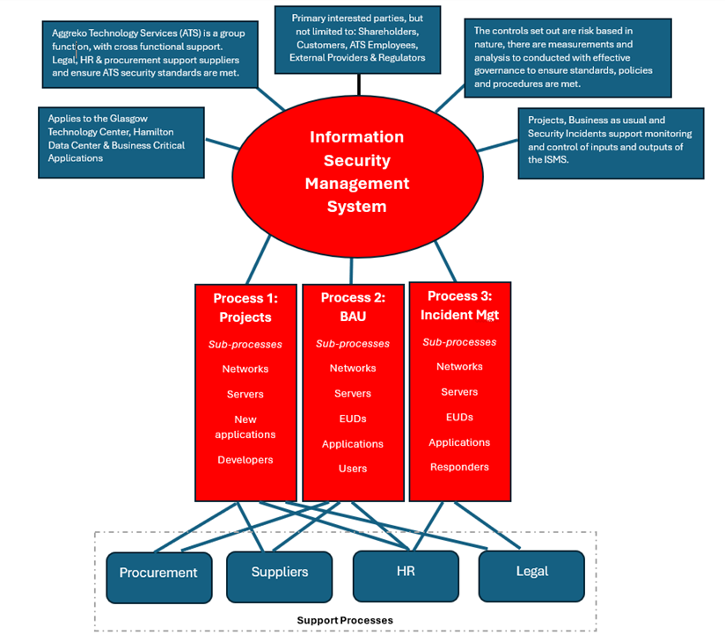
ISO27001 – ATS Scope and Design
PDCA Plan
ISO27001 – ATS Scope
“The scope of the ISMS Management System encompasses Information security and data assets supported and managed by the Glasgow Center, for our critical business applications”
Boundaries of the Information Security Management System
The Information Security Management System will be implemented at the Glasgow Center, Hamilton Data Center sites and will apply to Cloud Services provided by 3rd parties. The Physical boundaries for our ISO Management System Standards is documented in the ISMS Risk Register. Support functions and associated business managed processes are excluded from the scope of the audit.
Rationale
Allows for a wide scope to ensure we meet the Minimum Viable Product for ISO27001.
Focuses on our data assets and information security for key business applications.
Note this covers infrastructure, networks and EUC.
Glasgow Center is our primary workforce site.
Hamilton Data Center is our primary Data Center

Slide 9
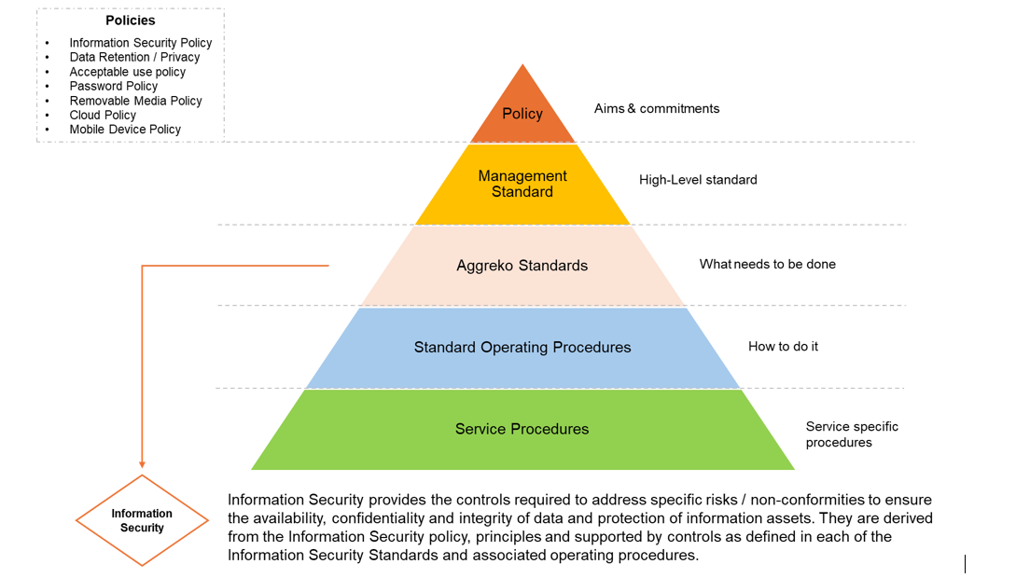
ATS – Proposed ISMS planning structure
PDCA; Plan
Below is an illustration of the high-level Information Security Management System in Aggreko. A management standard has been developed to guide the Senior Leadership Team, in reference to the management clauses, to advise on leadership, roles / responsibilities, planning and continuous improvement.

Slide 10
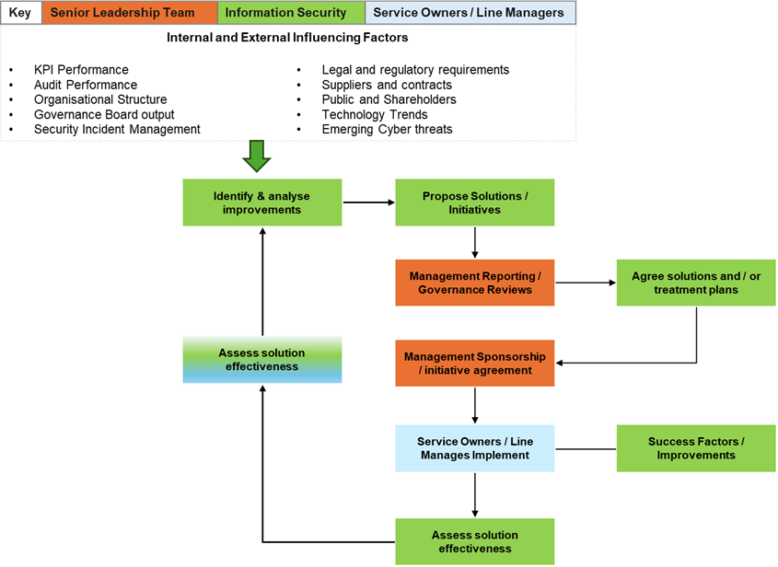
ATS – ISMS Continuous Improvement
PDCA Improvement
As part of ISO27001, we must continuously improve. The below framework describes how ATS can achieve this

Slide 11
Questions

Slide 12
Key Principle of Aggreko’s Governance

Slide 13
ISO27001 – Proposed Governance Boards; Risk Based
PDCA Plan

Slide 14
ISO27001 – Example Management Reporting Agenda
PDCA Improvement
The ISO27001 Standard sets out the following agent for the Management Review Meeting:
Tier 3
Name: Management Review
Purpose: Present and review findings of the ISMS
Scope: the status of actions from previous management reviews; changes in external and internal issues that are relevant to the information security management system; feedback on the information security performance, including trends in: nonconformities and corrective actions; monitoring and measurement results; audit results; and fulfilment of information security objectives;” feedback from interested parties; results of risk assessment and status of risk treatment plan; and opportunities for continual improvement.
Owner: Head of Security
Frequency: Monthly
Attendees: Senior Leadership Team
Supports / Informs: Tier 2 and 3 governance boards
Output: Action against non-conformance and corrective action on security objectives / risk, sign off continual improvement approach (may include investment) and advise on external factors (e.g. M&A)

Slide 15
Proposed ATS - Cyber Security Ops Forum Example
Key | No issues | Service Issues | Major Risk
Trend | Improving | Static / No change | Declining
Incidents
None in this period
Services
Volumetrics
Security status:
Green
Metrics | Jun-24 | July-24 | Aug-24 | Trend
# Security Incidents
# Security Events
# Malware
# Detected Vulnerabilities
# Security Incident containment
Antivirus
No challenges / issues
Endpoint Patching
No challenges / issues
Key Performance Indicators
Metrics | Jun-24 | July-24 | Aug-24 | Target | Status
Security incidents by change |  |  |  | 0%
Vulnerability Remediation |  |  |  | 15 Days - 99%
Anti-Virus Rate |  |  |  | 99%
Critical Patch Rate |  |  |  | 99%
Security Incident containment |  |  |  | 15 Days – 99%
Privileged Access |  |  |  | 99%
Server and Infrastructure Patching
No challenges / issues
Vulnerability (Penetration Testing, Scanning and New Threats)
No challenges / issues
Top 3 Security Risks
y Risks
Supplier Reporting
No challenges / issues
Top 3 Security Risks
Vulnerabilities across the estate
Additional Comments
PDCA Check

Slide 16
Questions

Slide 17
test

Slide 18
ISO27001 Framework
The framework
ISO27001 Framework
PDCA Application
Management Clauses
Plan; Establish the ISMS
4: Context of the organisation
Identify the needs of stakeholders and clarify their needs and interests
Define the scope of the ISMS
5: Leadership
Obtain commitment from leadership and establish policies
Define roles and responsibilities
6: Planning
Assess risks and vulnerabilities, as well as opportunities to improve information security
Do; Implement and Operate the ISMS
7: Support
Define and document resources for maintaining the ISMS
8: Operation
Define risk treatment plans and implement controls
Check; effectiveness
9: Performance evaluation
Monitor, measure and assess control effectiveness
Conduct internal audits and management reviews
Act; on improvements
10: Improvement
Identify nonconformities and corrective actions
Annex A Controls (94; Organisation, People, Physical & Technological)
Policies, Standards and Standard Operating Procedures

Slide 19
ISO27001 Framework
The framework
ISO27001 Framework
Plan
Management Clauses
4: Context of the organisation
Identify the needs of stakeholders and clarify their needs and interests
Define the scope of the ISMS
5: Leadership
Obtain commitment from leadership and establish policies
Define roles and responsibilities
6: Planning
Assess risks and vulnerabilities, as well as opportunities to improve information security
7: Support
Identify the needs of stakeholders and clarify their needs and interests
Define the scope of the ISMS
Do:
8: Operation
Identify the needs of stakeholders and clarify their needs and interests
Define the scope of the ISMS
9: Performance evaluation
Monitor, measure and assess control effectiveness
Conduct internal audits and management reviews
Check; effectiveness
10: Improvement
Monitor, measure and assess control effectiveness
Conduct internal audits and management reviews
Act; on improvements
Annex A Controls (94; Organisation, People, Physical & Technological)
Policies, Standards and Standard Operating Procedures

